Slide 1
Radcomms 2016 Day One
Disruption and Transformation
Mobile Broadband – Terrestrial Perspective

Slide 2
MWC - 2016
“Mobile is Everything”

Slide 3
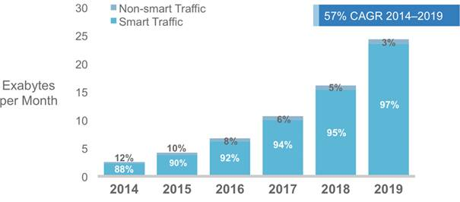
Effect of Smart Mobile Devices and Connections Growth on Traffic
CISCO VNI 2014

Slide 4
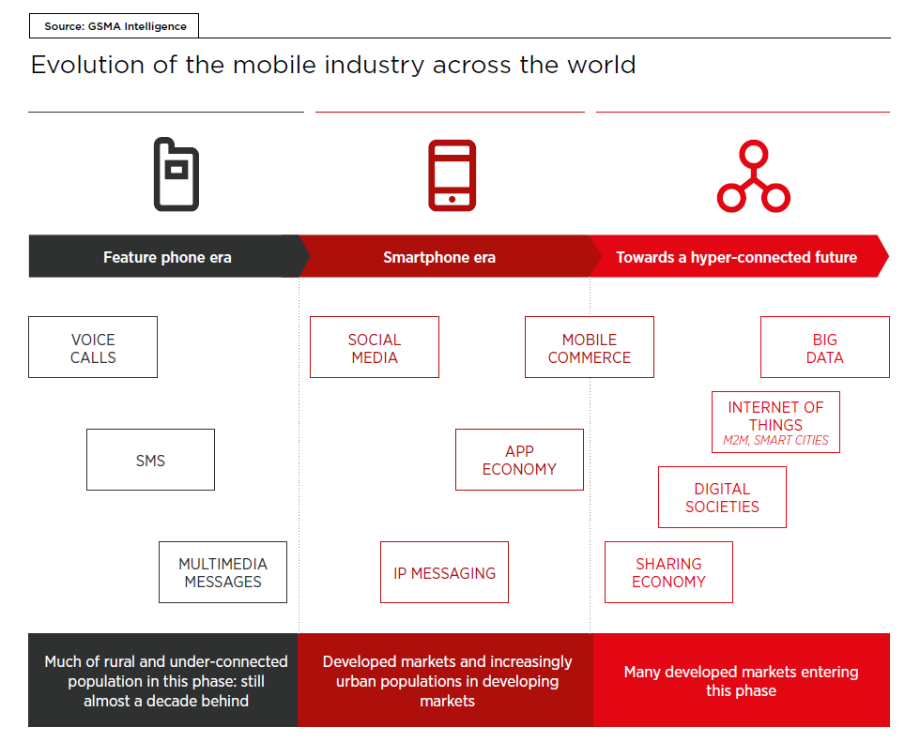
Evolution of the mobile industry across the world
Source: GSMA 2016

Slide 5
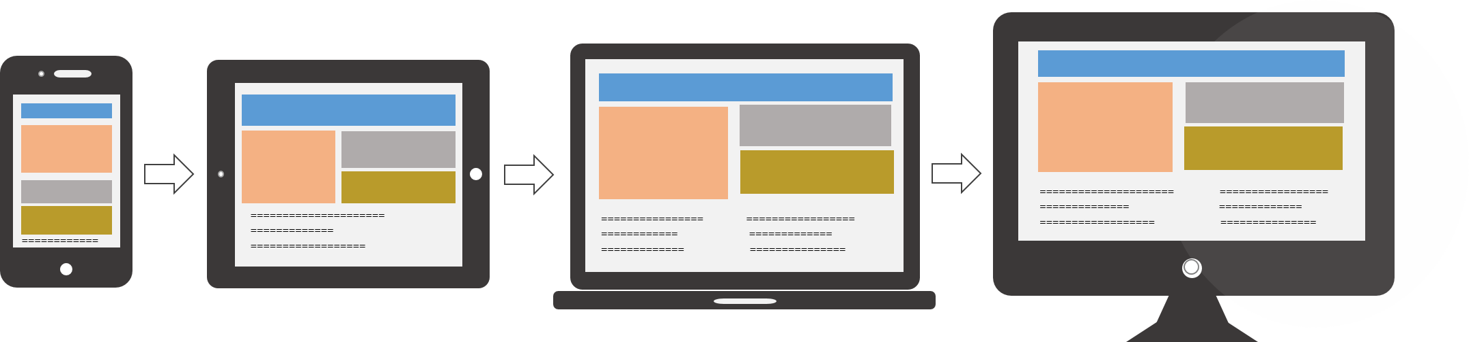

Mobile 1st Screen
1st

Slide 6
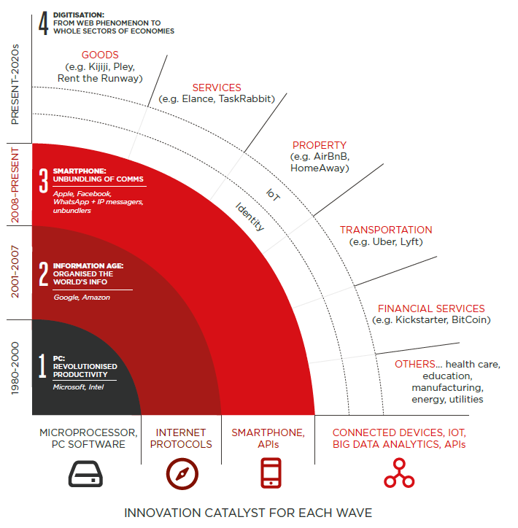
The fourth computing era: digitisation of wider economies
Source: GSMA 2016

Slide 7
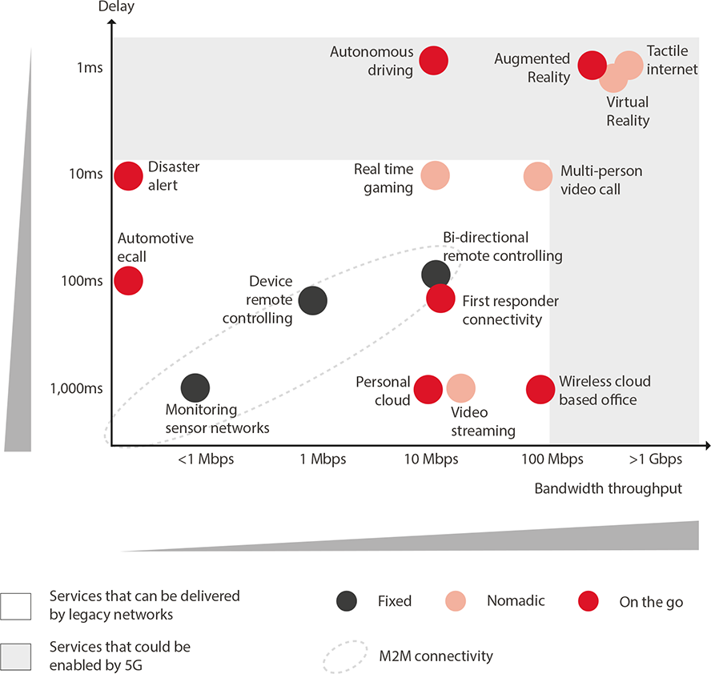
Network Performance – Services and 5G
GSMA 2015

Slide 8
Policy Issues for Mobile
Minimise regulatory burden – maximise opportunity
Focus on infrastructure policy settings – eg network deployment regulation and spectrum policy
“The allocation of spectrum will be one issue that could constrain or reduce the future economic value of mobile broadband.”
2014 “The economic impacts of mobile broadband on the Australian economy 2006-2013” - ACMA

Slide 9
Spectrum Demand
The ITU’s official spectrum demand model assumes that mobile traffic will increase between 44 - 80 times between 2010 and 2020.
ITU predicts that the rate of data growth means an average total of 1340–1960 MHz will be required for mobile broadband by 2020.

Slide 10
MBB Strategy – Highlights
AMTA supportive of a contingency-based holistic approach in place of spectrum targets
Separation of domestic and international processes
Highest value use assessments can be carried out at any stage → facilitate greater market-based activity
Influencing international spectrum harmonisation
WRC-15 outcomes – new bands for IMT

Slide 11
MBB Strategy – Key takeaways
“The ACMA will focus on the desired outcome—that is, delivery of mobile broadband services enabled by mobile broadband capacity, with provision of spectrum being one of several inputs to delivering this outcome.”
“The ACMA will….seek to provide the right spectrum at the right time to address the growth in demand for mobile broadband capacity.”

Slide 12
Beyond 2020….
ACMA strategy – good initial approach with refinements
WRC cycle – potential limiting factor
Respect for the balancing act for all stakeholders
Contemporary policy approach with matching ACMA strategy – a “must have” given ecosystem dynamics

Slide 13
Spectrum Review What does reform look like?
Transparency - providing a clear and transparent policy framework
Efficiency - promoting efficient allocation and use of spectrum
Flexibility - ensuring arrangements are as flexible as possible to promote choice and innovation
Certainty - providing confidence about regulatory arrangements and spectrum access terms and conditions and promote international harmonisation in Australia’s interests
Simplicity - creating a framework that is simpler, easier to understand and uses the least cost regulation required to achieve the objective
The proposed reform approach is to restructure and rationalise the legislative framework to:
provide for greater market-based activity
simplify regulatory structures, streamline regulatory processes and clarify the role for Government

Slide 14
New Framework thinking
Proactive approach – early response to market signals in consultation with industry – ongoing dialogue
Simultaneous planning – domestic and regional / international
Develop ability to prioritise spectrum flow of spectrum to market
Work with industry to understand complexities of dealing with demand
Future will rely on flexibility and agility – keep options open
Influencing and leading – spectrum and innovation

Slide 15
The road ahead: WRC-19 prep
WRC-19 Agenda item 1.13—ITU-R commitment to study spectrum for IMT in bands between 24.25 GHz and 86 GHz:
What is in: 24.25-27.5 GHz and mm-wave spectrum (above 31 GHz)
What is out: cm-wave spectrum (3-30 GHz)
ACMA monitoring domestically, Australia needs to be proactive and support internationally
WRC-19 Agenda item 1.16
5 GHz RLAN bands (5150-5350 MHz, 5350-5470 MHz and 5850-5925 MHz)

Slide 16
The road ahead: 5G
ACMA occasional research paper on 5G and mobile network developments
Indicates ACMA support for facilitating access to spectrum to accommodate increased use of mobile broadband, M2M and IoT
5G spectrum—both:
below 6 GHz, evolution of LTE
for applications requiring coverage, reliability, and/or narrowband signals
above 6 GHz, new radio access technology envisioned
for increasingly wider bandwidth applications in both cm-wave (e.g. 15 GHz) and mm-wave (e.g. 37 GHz, 39 GHz, 73 GHz) spectrum

Slide 17
The road ahead: 5G
5G network architecture
Shift in focus from technology to use cases (e.g. ‘Network Slicing’)
5G use case examples
‘Extreme’ mobile broadband incl. 4K video and Virtual Reality—low latency, very high bandwidth
Massive MTC incl. sensor networks—low latency, narrow bandwidth, low power consumption, massive number of connections
Autonomous driving—ultra-reliable and low latency comms required
5G standardisation work commenced
5G trials
Partnerships between carriers and vendors to test 5G prototype systems capable of tens of gigabits per second throughput, and featuring Multi-User MIMO, Massive MIMO and beam-forming, along with new modulation techniques

Slide 18
The road ahead: IoT
IoT a major driver of 5G….
5G a major enabler of IoT
Key spectrum for IoT
Typical use of existing proprietary standalone networks is in class-licensed ISM bands
Some IoT techs will be able to operate in licensed GSM & LTE bands
5G spectrum above 6 GHz may be used for future IoT
IoT standardisation
3GPP developing specifications for three main technologies: LTE-M, NB-IoT, EC-GSM-IoT

Slide 19
Continued Evolution of 4G
5G is not the only next step
Mobile communications services will continue to improve between now and commercialisation of 5G (anticipated for 2020)
‘4.5G’ and ‘1 Gbps LTE’
Coverage and performance of 4G networks are being improved through incremental upgrades under LTE-Advanced standard:
Carrier Aggregation
MIMO
Higher-order modulation schemes

Slide 20
Final thought
“Mobile sits at the heart of a new ecosystem that is uniting the digital and physical worlds and powering economic growth.”
2015 Anne Bouverot Director General GSMA

Slide 21
Thank you

